Slide 1
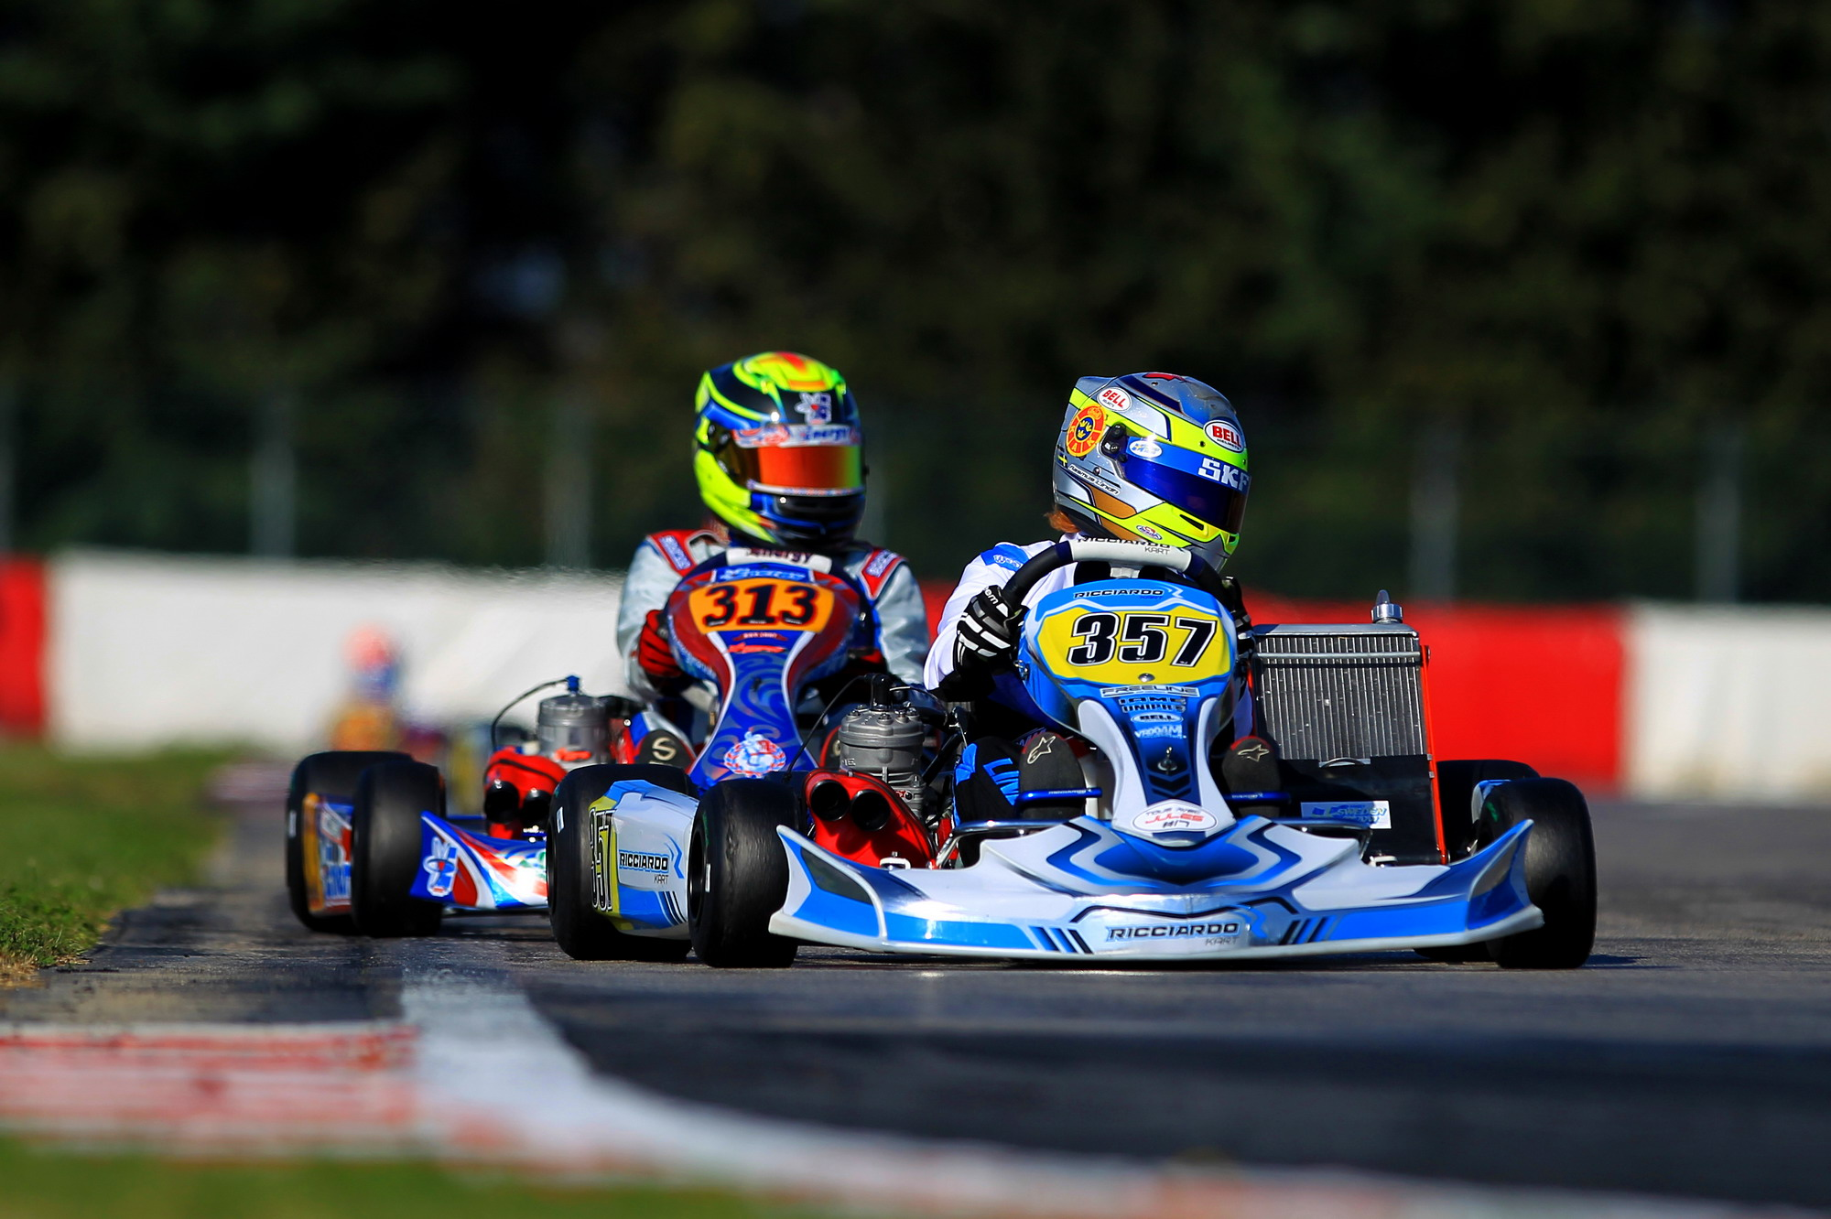
Projeto Individual | Word Kart
Eduardo Francisco de Oliveira Filho
RA: 01221149
This Photo by Unknown author is licensed under CC BY-NC-ND.

Slide 2
Contextualização
This Photo by Unknown author is licensed under CC BY-NC-ND.

Slide 3
Valores:
Gratidão
Persistência
Resiliência
This Photo by Unknown author is licensed under CC BY-NC-ND.

Slide 4
Maior dificuldade:
Back-end
This Photo by Unknown author is licensed under CC BY-NC-ND.

Slide 5
Maior Superação:
Front-end
Banco de dados
Gestão
This Photo by Unknown author is licensed under CC BY-NC-ND.

Slide 6
Agradecimentos:
Faculdade
Amigos de sala
(Especial) Diogo Henrique
This Photo by Unknown author is licensed under CC BY-NC-ND.

Slide 7
Conclusão:
Muito Aprendizado
Superação
Longo caminho pela frente
This Photo by Unknown author is licensed under CC BY-NC-ND.

Slide 8
Vídeo Bônus:
This Photo by Unknown author is licensed under CC BY-NC-ND.

